Slide 1
The Water Cycle
4th Grade
Lisa Dayton

Slide 2
Why does it rain?
Has anyone ever heard of the water cycle?
What do you think the water cycle might be?
How does water get into clouds before it starts to rain?
Do you think the sun is part of the water cycle?
Engage
https://www.youtube.com/watch?v=auvGBmIxG08&t=123s

Slide 3
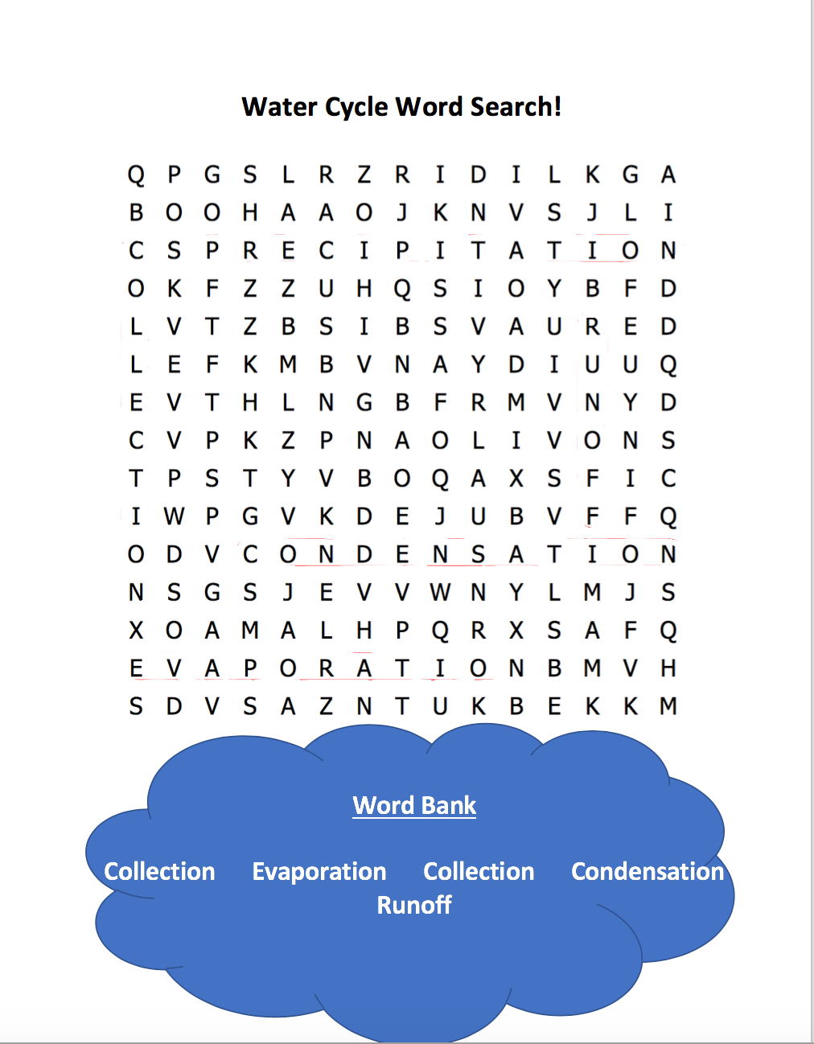
Explore-Vocabulary Word Search!
Groups of 4-5

Slide 4
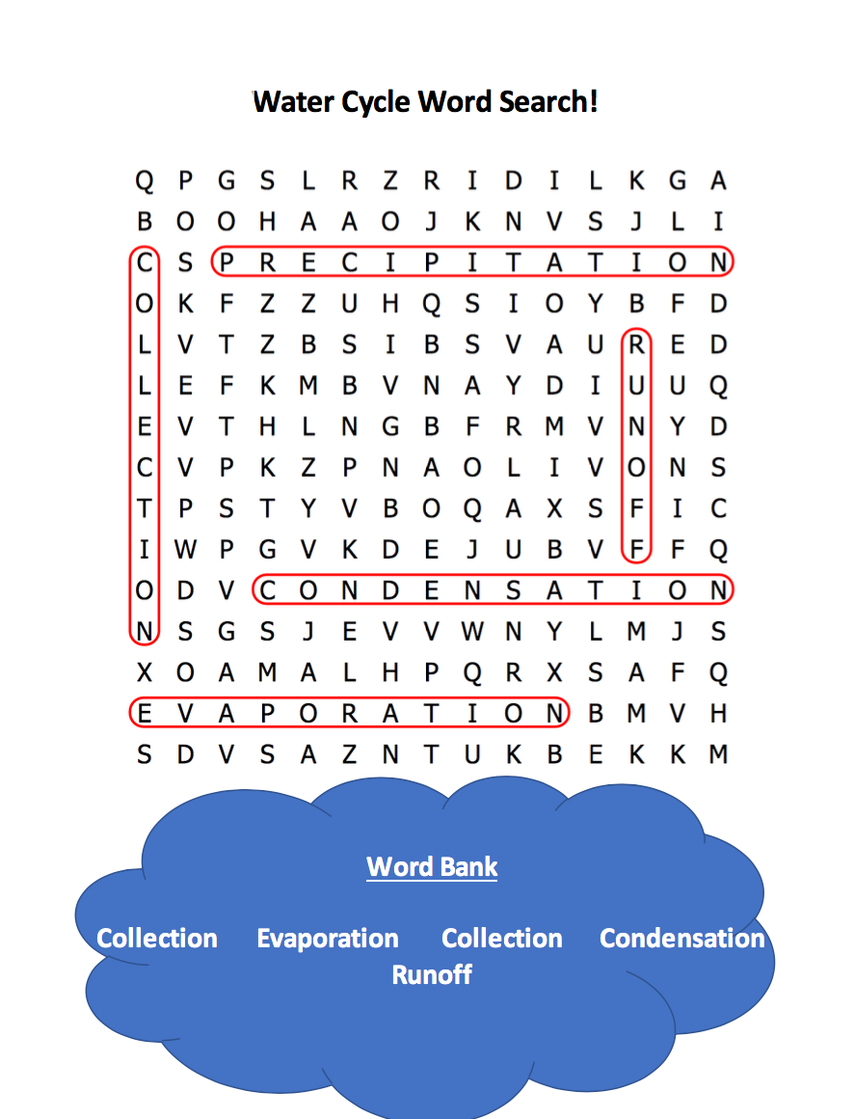

Slide 5
What stage does this represent?
Explain- Whiteboards, markers, and erasers
Hands sway above*

Slide 6
What stage does this picture represent? Discuss and identify!
Huddle with group*

Slide 7
Discuss
Hands rain down*

Slide 8
What stage does this represent?
One big class!*

Slide 9
Look closely!
Hardcover book**

Slide 10
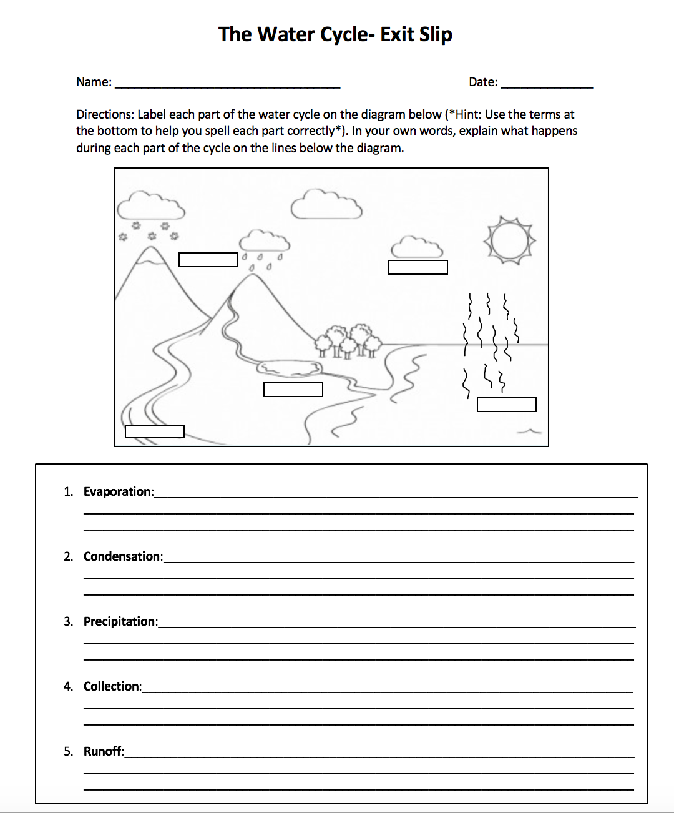
Evaluate- Exit Slip

Slide 11
End- What did you learn about the water cycle?

