Slide 1
Plant Adaptations
Standard: 4.L.5B.2- Construct explanations for how structural adaptations (such as the types of roots, stems, or leaves; color of flowers; or seed dispersal) allow plants to survive and reproduce.

Slide 2
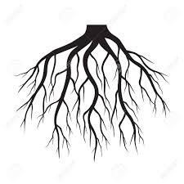
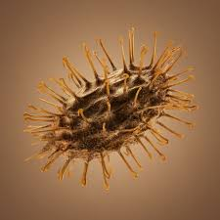
Recall- Plant Structures
Raise your hand and tell me what roots do for a plant.
-What about stems?
-Leaves?
-Flowers?
-Fruits?
-Seeds?

Slide 3
Adaptations in Plants: Video Lesson for Kids -The video will discuss various plant adaptations and how they help certain plants survive and reproduce in their environment.
https://www.youtube.com/watch?v=Mbj_WQ76F1Q

Slide 4
Help Me Match!
We’re going to play a little game!
Look at the picture and look at the adaptation choices. We need to match 3 cards to each plant.
Think about any special features that would help the plant survive and think about roots, stems, leaves, flowers, fruits, and seeds!
Unmute yourselves and tell me which adaptation card you think might match the plant.
Ready?

Slide 5
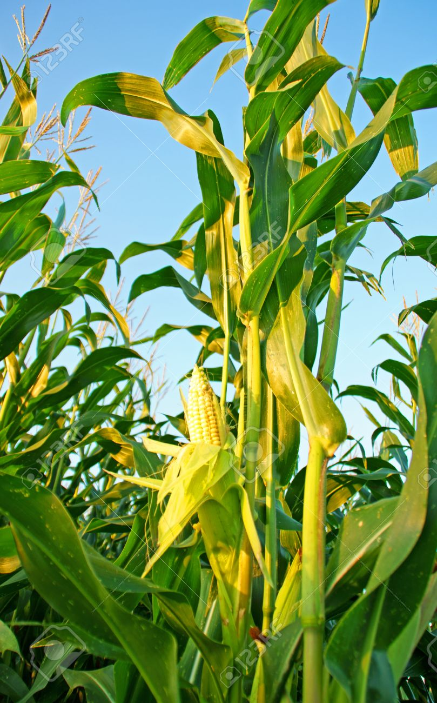
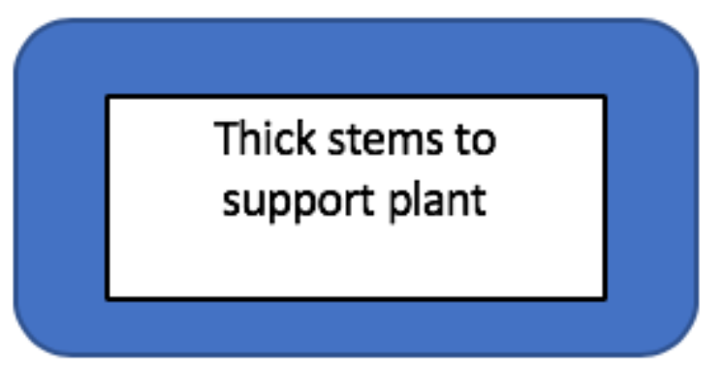
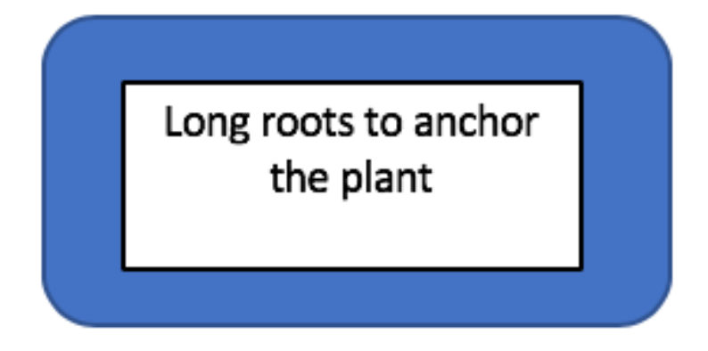
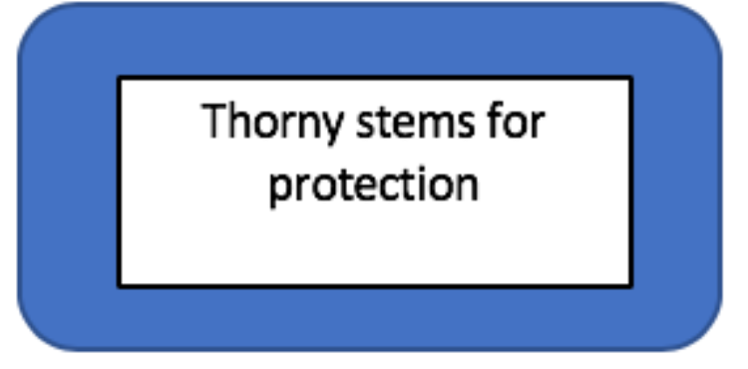
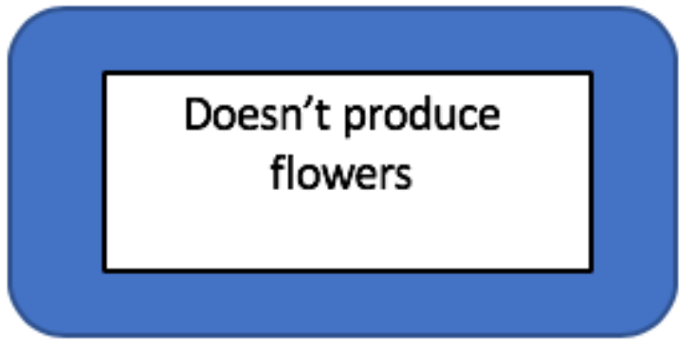
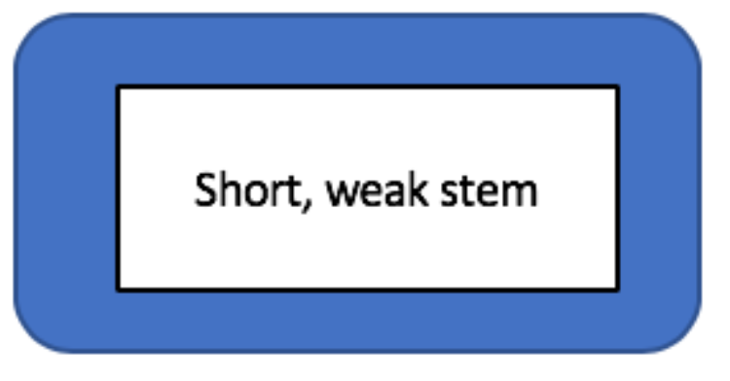
Help Me Match- Corn

Slide 6
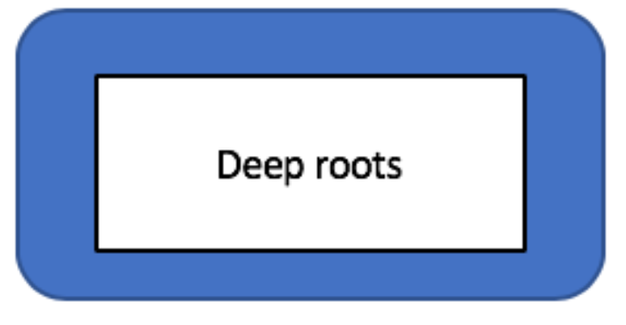
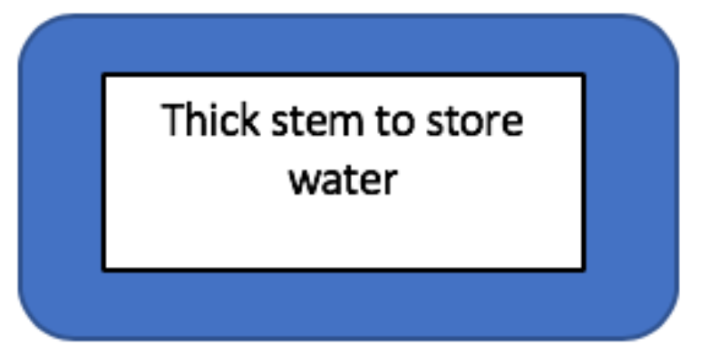
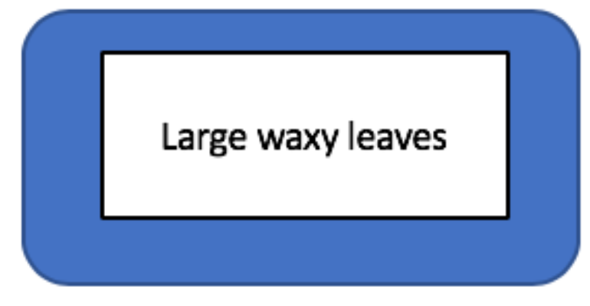
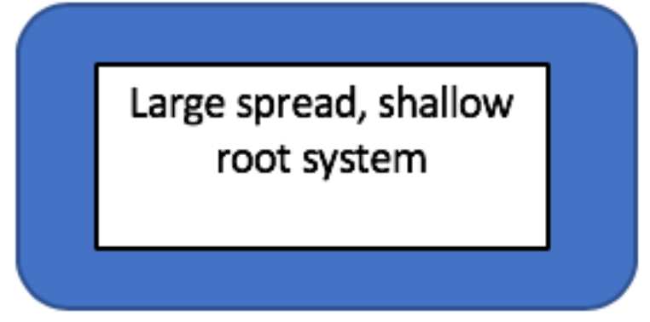
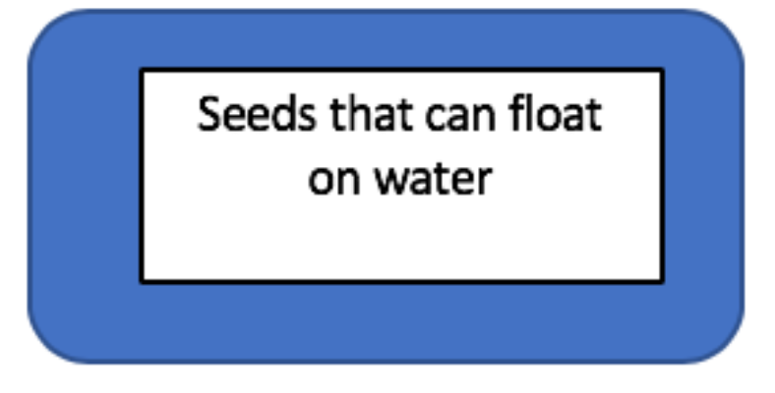
Help Me Match- Cactus

Slide 7
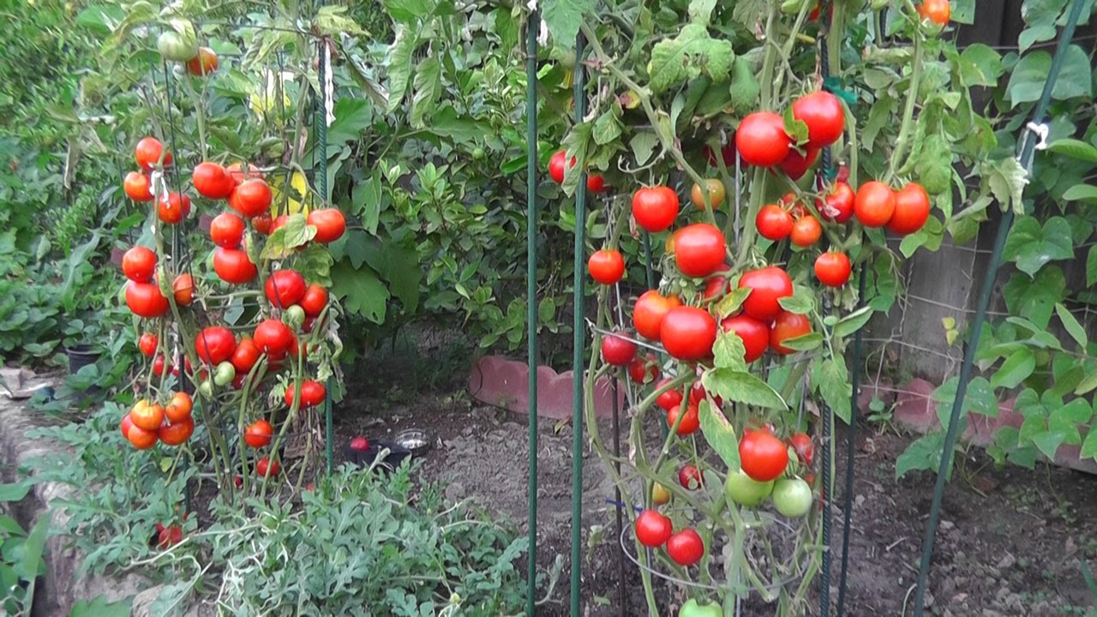
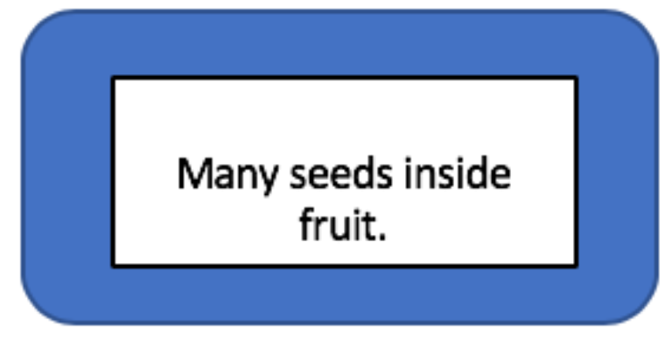
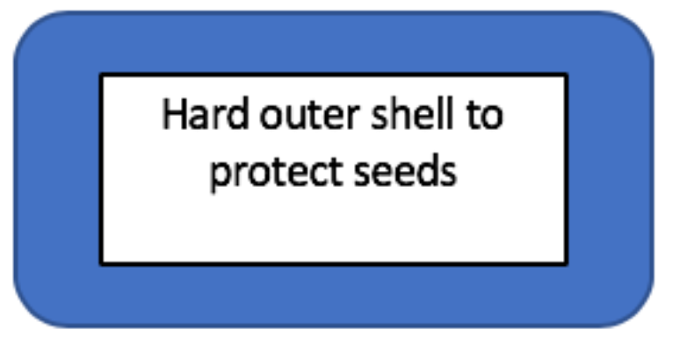
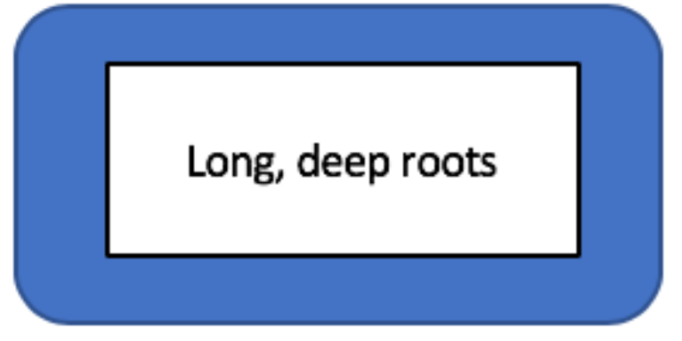
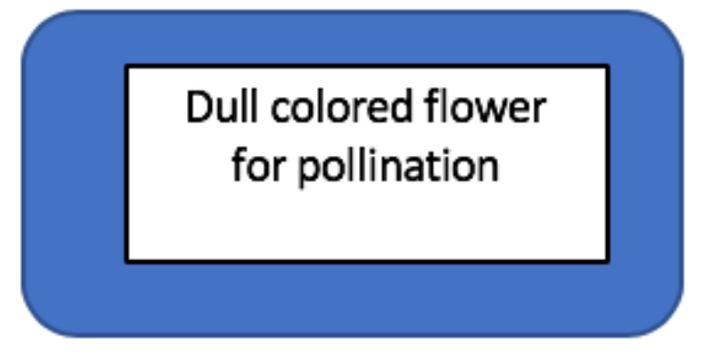
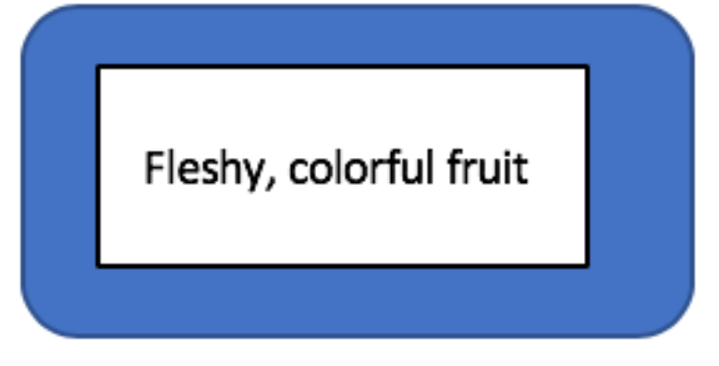
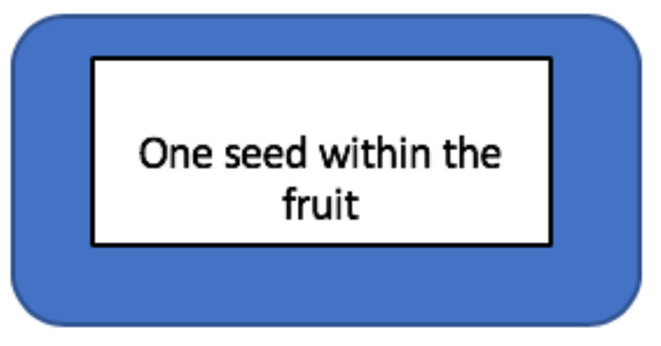
Help Me Match- Tomato Plant

Slide 8
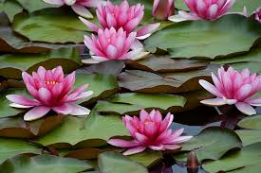
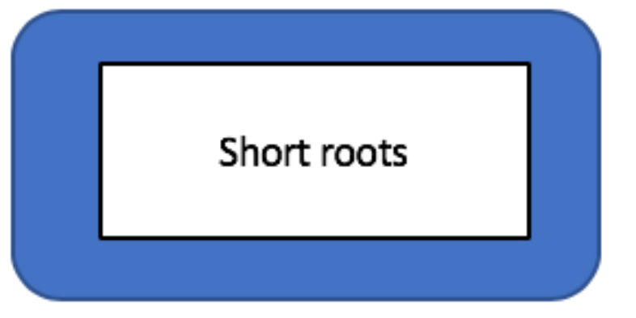
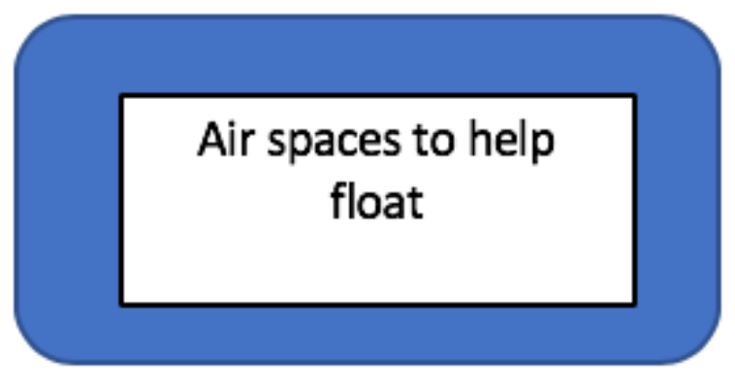
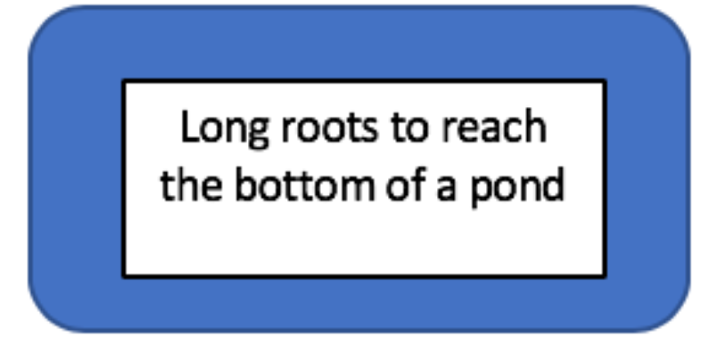
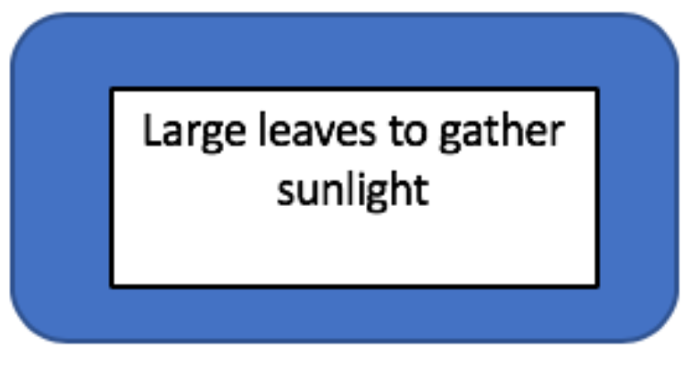
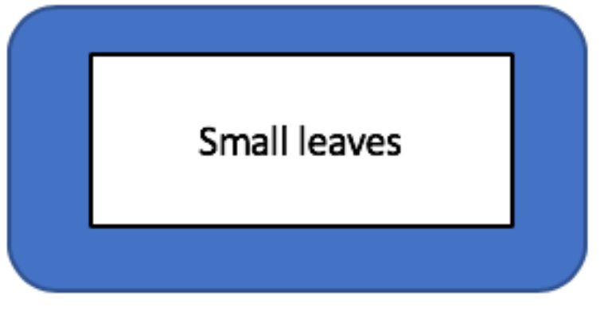
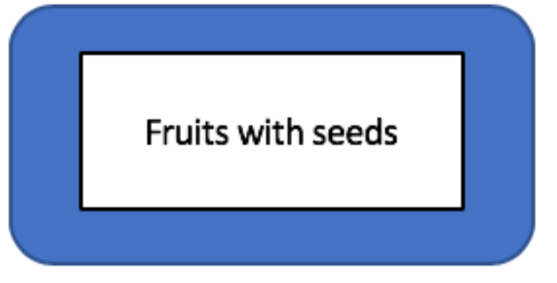
Help Me Match- Water Lily

Slide 9
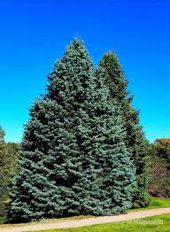
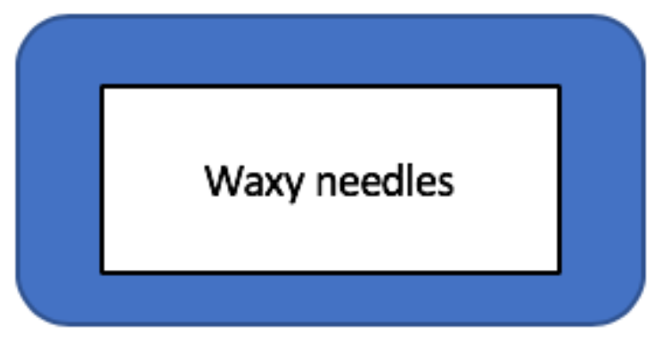
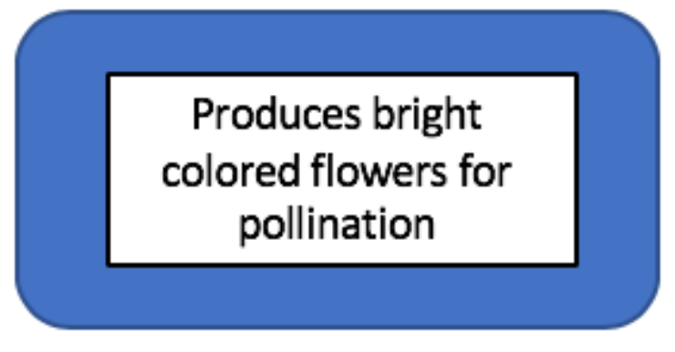
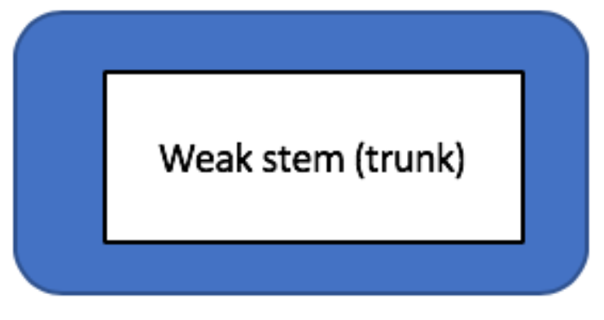
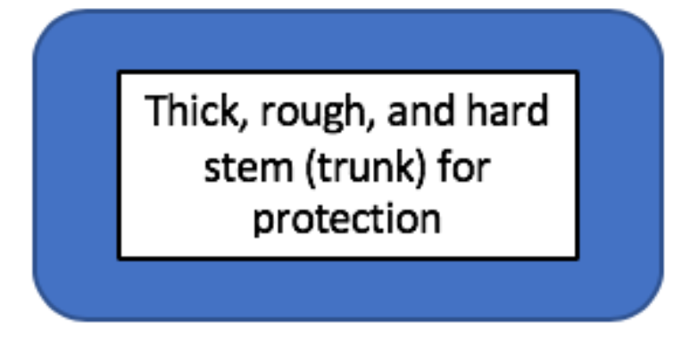
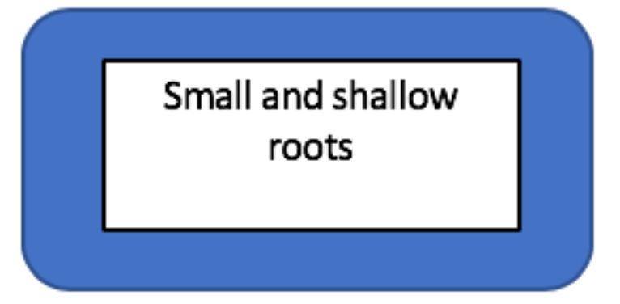
Help Me Match- Evergreen Tree

Slide 10
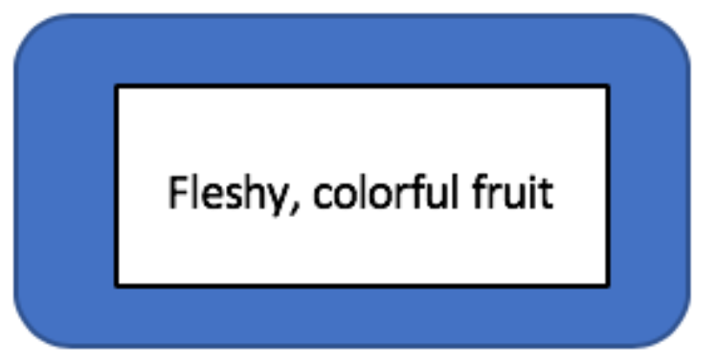
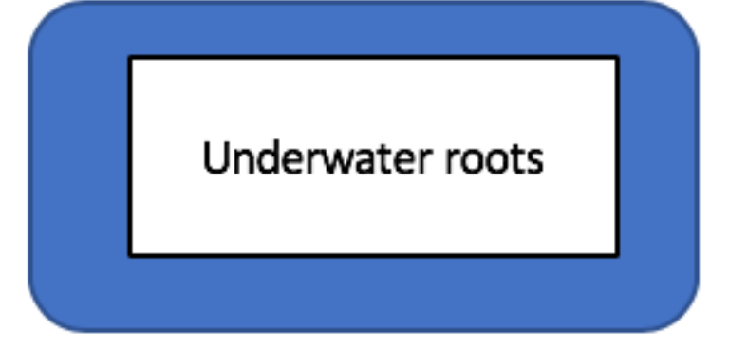
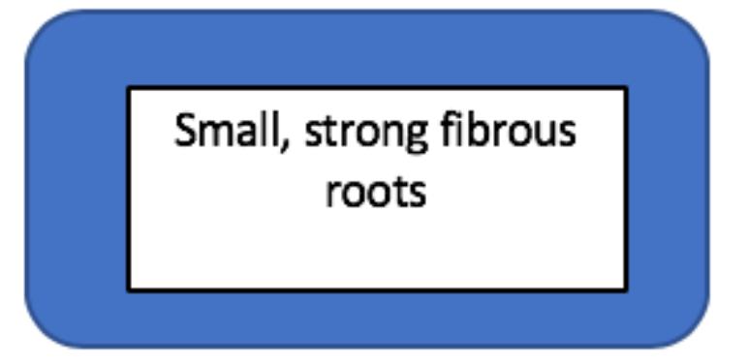
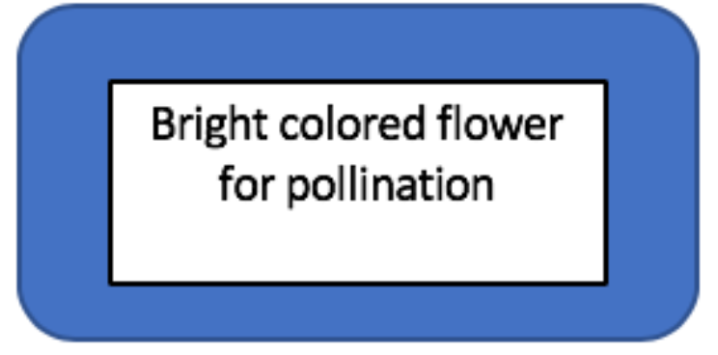
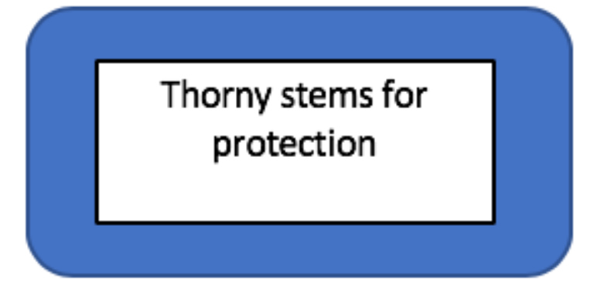
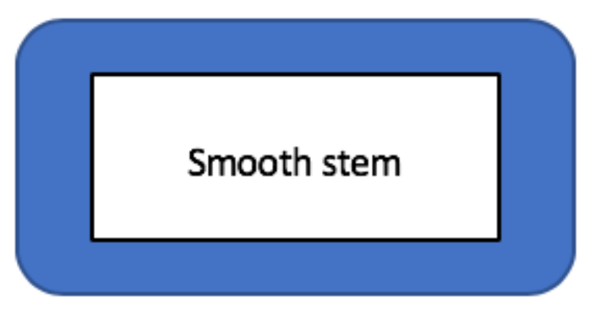
Help Me Match- Rose

Slide 11
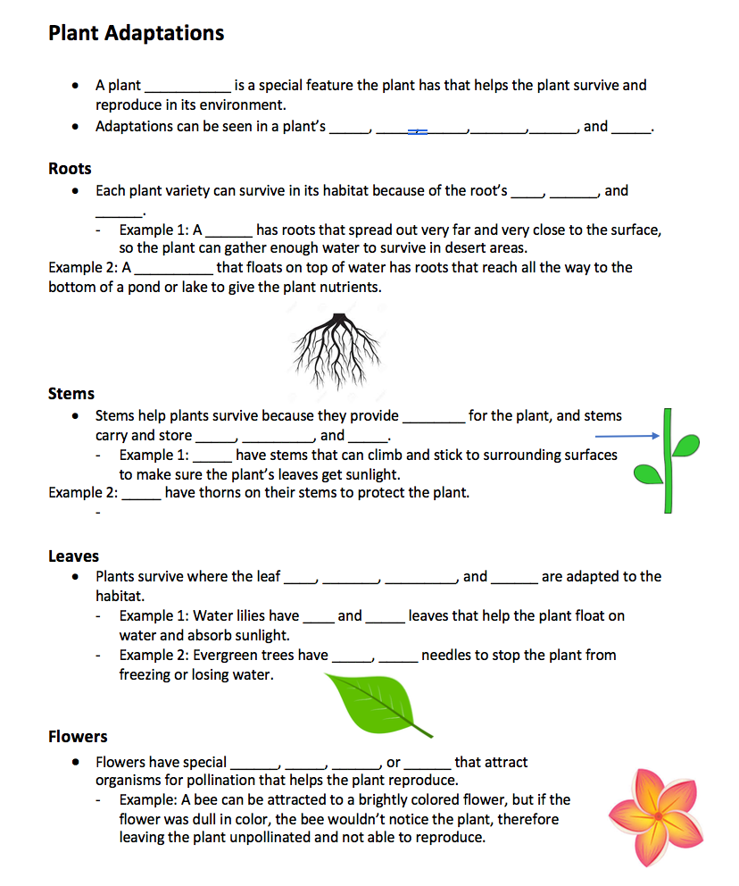
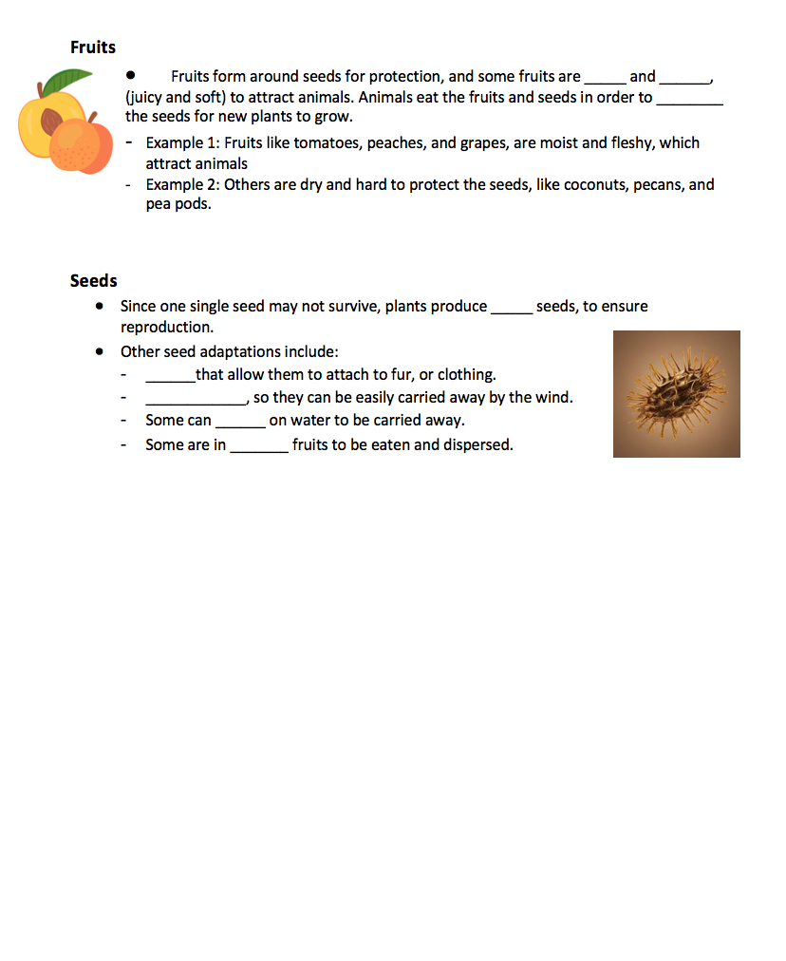
Now that you have seen some examples of adaptations…
Take out the guided notes that you have in your packet. It should look like this:
*We will fill in the blanks together, and you will glue them into your science notebooks!*

Slide 12
Plant Adaptations
A plant ___________ is a special feature the plant has that helps the plant survive and reproduce in its environment.
Adaptations can be seen in a plant’s _____, _____,______,_______,______, and _____.
Roots
Each plant variety can survive in its habitat because of the root’s ____, ______, and ______.
Example 1: A ______ has roots that spread out very far and very close to the surface, so the plant can gather enough water to survive in desert areas.
Example 2: A __________ that floats on top of water has roots that reach all the way to the bottom of a pond or lake to give the plant nutrients.
adaptation
roots
stems
leaves
flowers
fruits
seeds
size
length
spread
cactus
water lily

Slide 13
Stems
Stems help plants survive because they provide ________ for the plant, and stems carry and store _____, _________, and _____.
Example 1: _____ have stems that can climb and stick to surrounding surfaces to make sure the plant’s leaves get sunlight.
Example 2: _____ have thorns on their stems to protect the plant.
Leaves
Plants survive where the leaf ____, _____, _______, and ________ are adapted to the habitat.
Example 1: Water lilies have ____ and _____ leaves that help the plant float on water and absorb sunlight.
Example 2: Evergreen trees have _____, _____ needles to stop the plant from freezing or losing water.
support
water
nutrients
food
Vines
Roses
size
shape
texture
thickness
big
wide
thin
waxy

Slide 14
Flowers
Flowers have special ______, _____, ______, or ______ that attract organisms for pollination that helps the plant reproduce.
Example: A bee can be attracted to a brightly colored flower, but if the flower was dull in color, the bee wouldn’t notice the plant, therefore leaving the plant unpollinated and not able to reproduce.
Fruits
Fruits form around seeds for protection, and some fruits are _____ and ______, (juicy and soft) to attract animals. Animals eat the fruits and seeds in order to ________ the seeds for new plants to grow.
Example 1: Fruits like tomatoes, peaches, and grapes, are moist and fleshy, which attract animals
Example 2: Others are dry and hard to protect the seeds, like coconuts, pecans, and pea pods.
sizes
shapes
smells
colors
moist
fleshy
disperse

Slide 15
Seeds
Since one single seed may not survive, plants produce _____ seeds, to ensure reproduction.
Other seed adaptations include:
______that allow them to attach to fur, or clothing.
____________, so they can be easily carried away by the wind.
Some can ______ on water to be carried away.
Some are _______ fruits to be eaten and dispersed.
many
Hooks
Light weight
float
inside

Slide 16
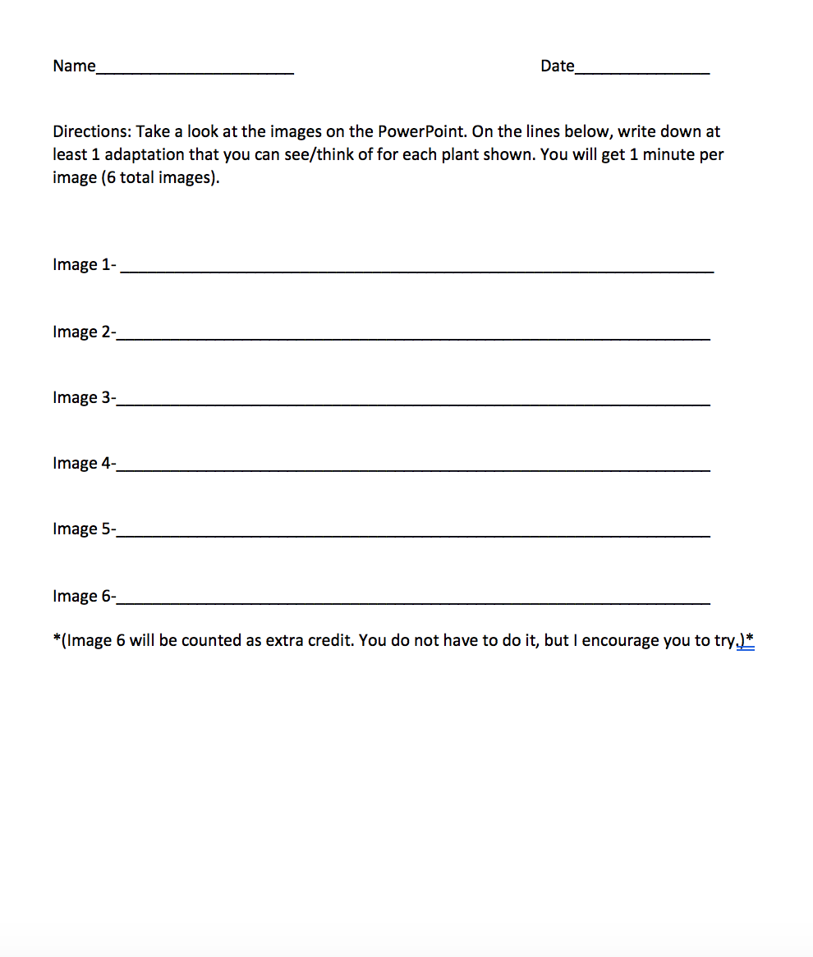
Now, take out the exit slip in your packet. It should look like this:

Slide 17
Image 1

Slide 18
Image 2

Slide 19
Image 3

Slide 20
Image 4

Slide 21
Image 5

Slide 22
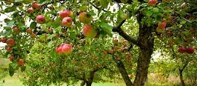
Image 6 (EC)

Slide 23
End of Less Challenge:
Now you know so many different types of adaptations!
What are some plants around your house or community?
Look around and find one adaptation that you can see, or one that you think the plant has, and draw a picture of it.
Have your drawing with you the next time we Zoom and we will share our findings.

